Slide 1
food recognition and calorie measurement using machine learning

Slide 2
Introduction
People are generally considered obese when their Body Mass Index (BMI) is over 30 kg/m2. High BMI is associated with the increased risk of diseases, such as heart disease. Unfortunately, more and more people will meet criteria for obesity. The main cause of obesity is the imbalance between the amount of food intake and energy consumed by the individuals. Obesity treatment requires the patients to eat healthy food and decrease the amount of daily calorie intake, which needs patients to calculate and record calories from foods every day.
While computer vision-based measurement methods were introduced to estimate calories from images directly according to the calibration object and foods information, obese patients have benefited a lot from these methods.
In this project, I study the application of deep learning for food classification and recognition.
The main contributions of this project are listed as follows:
Proposing the first recognition system for food.
Proposing an effective calorie estimation method

Slide 3
Problem Statement
Now a days people are becoming more and more conscious about their eating habits they want to calculate calories, fats, proteins present in their intakes but the problem is one can not always have diet chart or he/she can not always Google food ingredients to calculate calories or fats or proteins there should be some app which can detect calories at single click.

Slide 4
Objective
To detect food type by using YOLO( You Only Look Once) which uses Convolutional Neural Network (CNN)
Proposed AI&ML based calorie estimation app which will detect food item from image and gives approximate calories present in that item.

Slide 5
Literature survey
Sr No. | Reference Name (Write Paper Title) | Seed Idea/ Work description | Problems found | Any other criteria | Proposed System
1 | An automatic calorie estimation system of food images on a smartphone | An image-based calorie estimation system which runs on a consumer smartphone without external recognition servers | Predefine Reference Object as plate needed , multiple food items recognition have less accuracy | NIN-CNN based recognition engine used | Thumb as referance Object and can run without any external servers
2 | Image-Based Estimation of Real Food Size for Accurate Food Calorie Estimation | An image-based calorie estimation system which detects multiple food items in an image | Stereo mode supported device is required | U-NET CNN based Used for recognition | YOLO (CNN) algo and OpenCV image processing techniques is used
3 | Calorie estimation using deep learning techniques | An Images based system to estimate calories | Uses coin as predefined object | Used R-CNN | Referance object is Thumb and CNN with max pooling layers used
4 | Calorie-estimation-from-food images-openCV May 2016 | Can Predict for Single food item at a time | They used too much filters which increases time | Uses SVM | We used YOLO (CNN based) system for Object Detection and recognition

Slide 6





SYSTEM ARCHITECTURE
TAKE IMAGE OF FOOD ITEM
DETECTION OF FOOD ITEMS
SEGMENTATION OF FOOD ITEMS AND PREREGISTERED REFERENCE OBJECT
CALCULATE FOOD CALORIE FROM THEIR SIZE
DISPLAY CALORIES CALCULATED

Slide 7
Block Diagram
Acquisition
Input
Object Localization,
Classification
And Segmentation
Food image with Reference Object is Segmented & Classified
Weight Approximation
Food_approx_weightValue_pixel_per_inch_sq_value
Calorie Estimation
Food Items present in Image, Estimated calorie Content
Point and Shoot from Camera
Image
Food Items Classified
Approxi-mate
Weights
Estimated calorie Content
YOLO,OpenCV
Object
Referencing

Slide 8
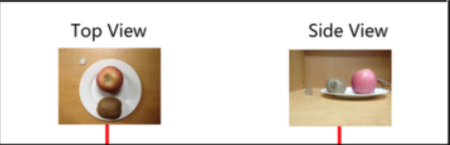
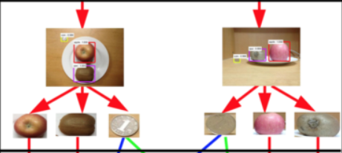
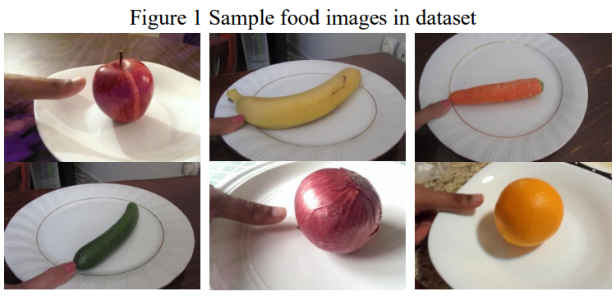
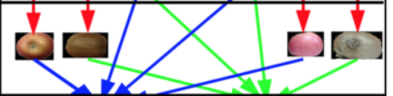
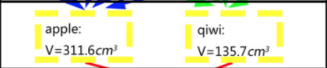
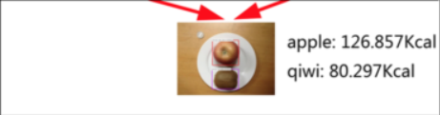
ALGORITHM FLOWCHART
Object detection
Volume Estimation
Calorie Estimation
Image Acquisition.
Image Segmentation

Slide 9




ALGORITHM FLOW
Algorithms Process Flow for every 1 Complete Cycle
Deep Learning
Computer Vision
For Detection & Classification:
We are using YOLO (You Only Look Once) Algorithm which contains many CNN based layers.
There are few techniques In OpenCV used for Segmentation:
Thresholding ,Contours finding, and some image pre processing filters
Our System
Display The Calories
Calculation :
Display the Approximate Amount Of Calories Of That Food Object Predicted By Our System. If Required Run The System Again For New Calculations
Now Our Model Have Pre-defined Referance Object Area, Food Area and required values that will help for Calculating Calories.

Slide 10
UML-DFD level Diagram
1
Object detection
2
Calorie Calculation
Object Extraction
Segmentation of Objects from background
CNN method for identification of food Objects
Food Object Shape and It’s Volume
Identified Food Object Label
Take Photo
Internal System
Display Calories estimated
DFD at level 0
DFD at level 1
DFD at level 2

Slide 11

UML - Collaboration Diagram
If Photo Is Blur
Take Photo from User
Object Detection
Extraction and segmentation
Image
object detected area
Fruit area
And
Referance object area
Display Name Of Fruit and Calories
calorie estimation
Volume Estimation
Fruit Volume

Slide 12
UML - Sequence Diagram
System
Take Photo with proper light
Object Detection
Object Extraction
Object Segmentation
Object labelling
Volume Estimation
Calorie Estimation
User
If photo is blur
Take Photo again
Processing
Calories (Output)

Slide 13
UML - Class diagrams
Train set and Data Pre-processing
Data Augmentation arguments like rotation, width-shift, height-shift, shear, zoom
Building CNN
Dataset
Test set and Data Pre-processing
Training CNN
Analysis Of Results
Estimation Of Calories
Making Predictions For New Images.

Slide 14
UML – Activity Diagram
Start
Open Application
Stop
Get the Image
Yes
Calorie Estimation
Yes
Object Detection
If Image isn’t proper
If Any error Occurred
No
Process with CNN
No
Volume Estimation
Object Extraction

Slide 15
Agile Methodology
Agile methodology In out System
Calories Estimation
3
1
2
3
Test
Deploy
Build
Segmentation
2
Test
Deploy
Build
Object Detection and Extraction
1
Test
Deploy
Build

Slide 16
Applications
The Applications are :
This proposed system can help in Healthcare
In order to Classify kind of Food we can use this system .
Can Predict the approximate Amount of Calories present in the Food
We also can measure the Approximate Area of that Food object

Slide 17
Advantages
Classification Of Food Objects has become easy now .
We can Estimate the Approximate Calories of food even without knowing Actual weight of Food objects.
We can meet with out results only using Image as Inputs.
We can do both ways we can deploy this system with help of servers or we can use it offline .
We now can use more feasible reference object for our system .

Slide 18
Disadvantages
If the Input ( Image of Food ) is taken in Improper ways it directaly affects on Accuracy of Prediction .
Currently Proposed system can only work on fruits .
Current Proposed System can only estimate the calories of 1 Food object at a time

Slide 19
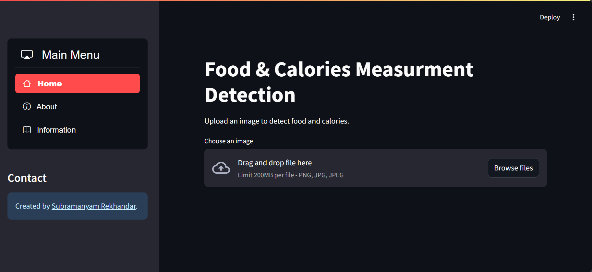
Results

Slide 20
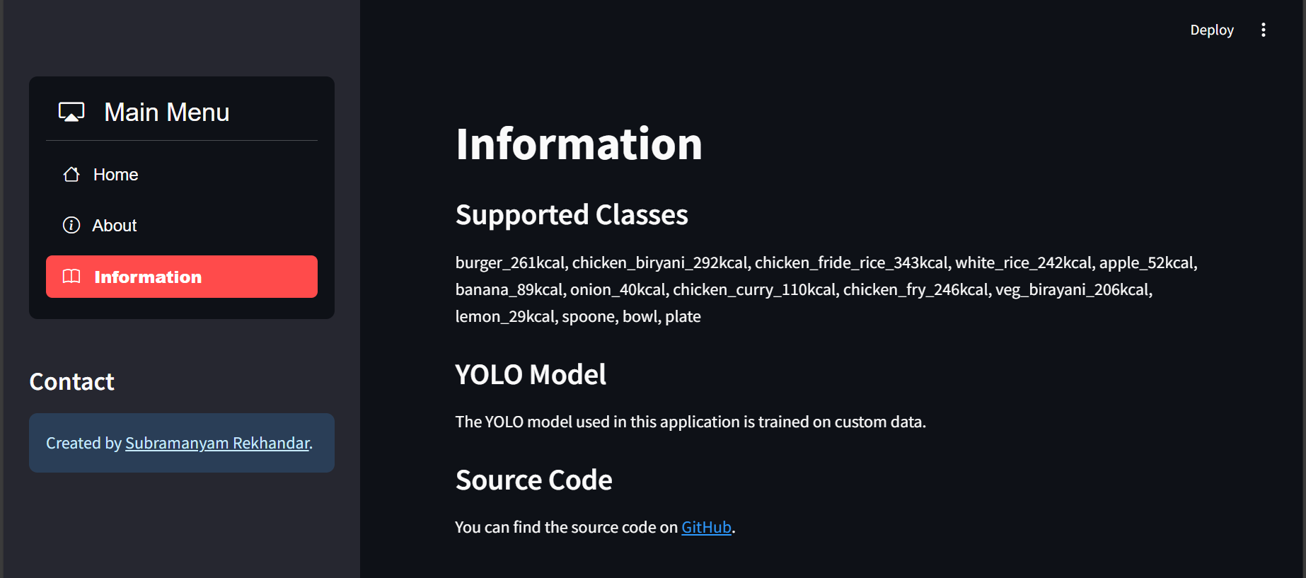
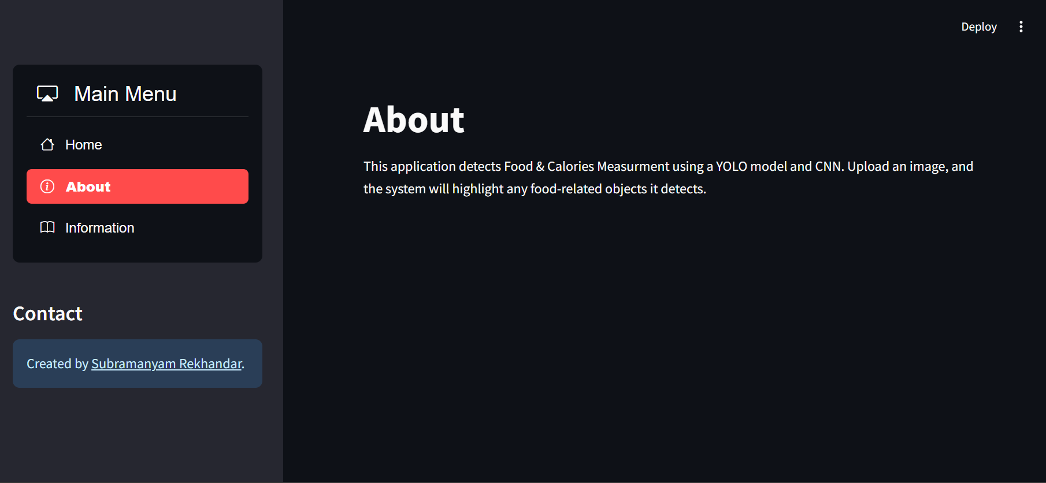

Slide 21
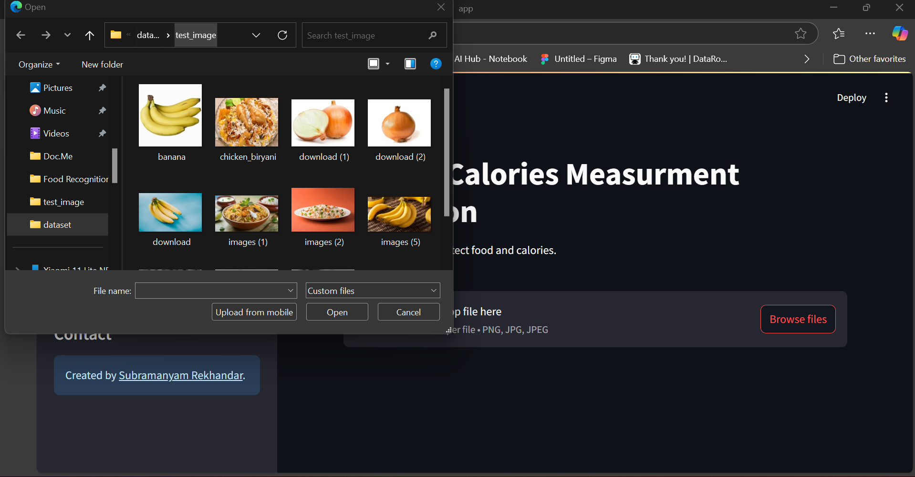

Slide 22
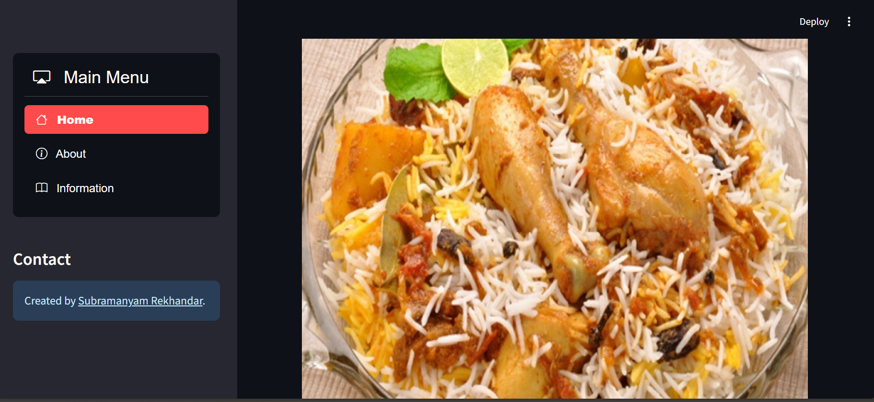
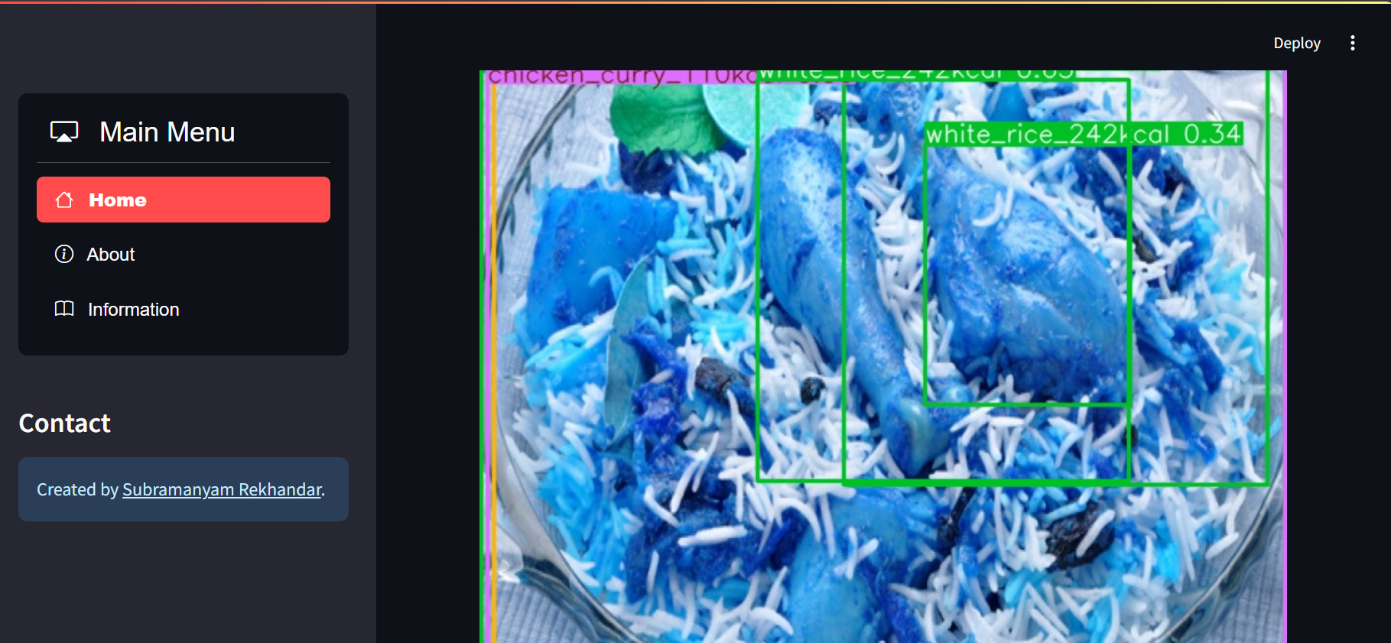
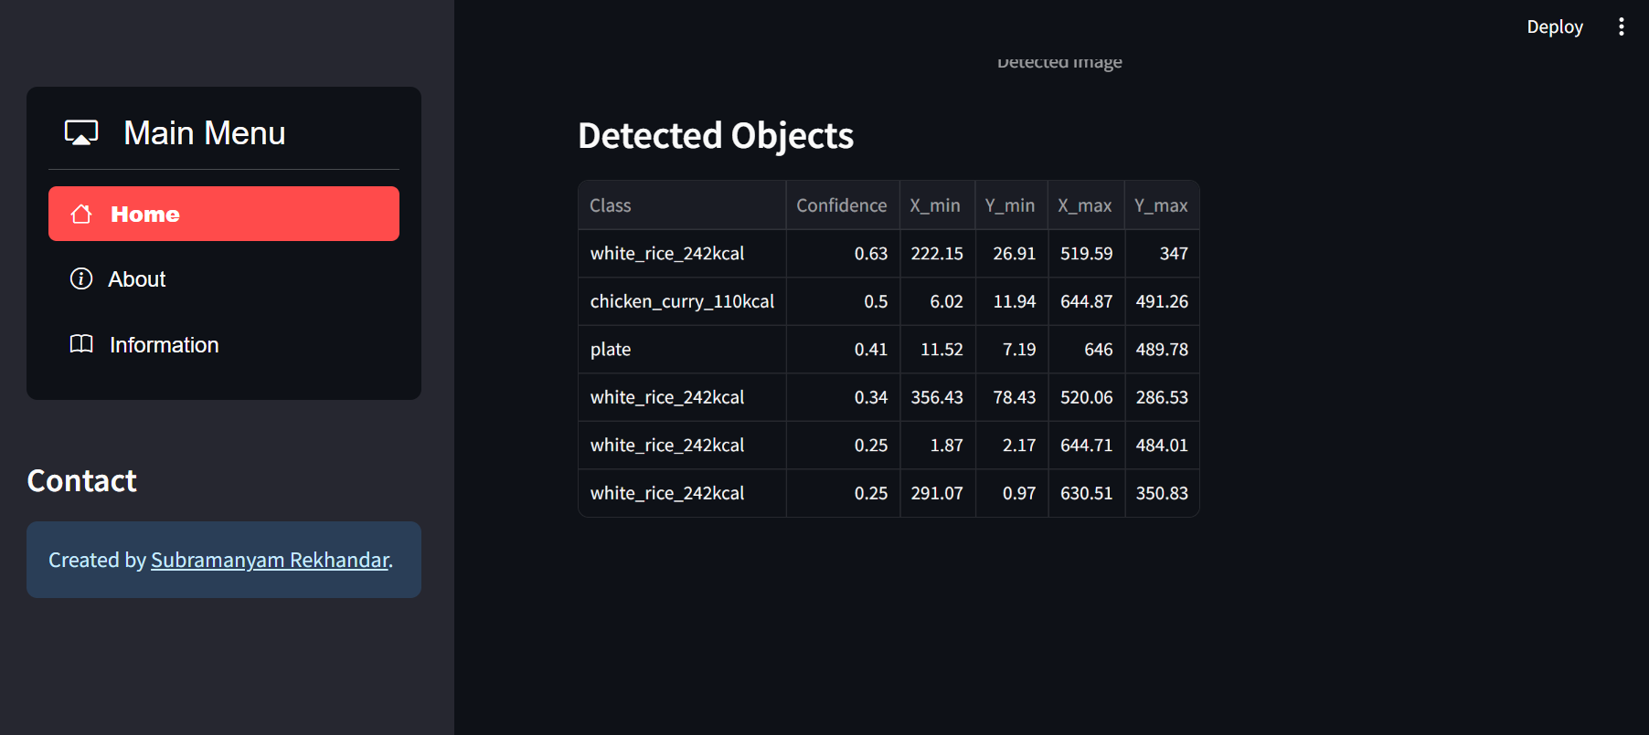

Slide 23
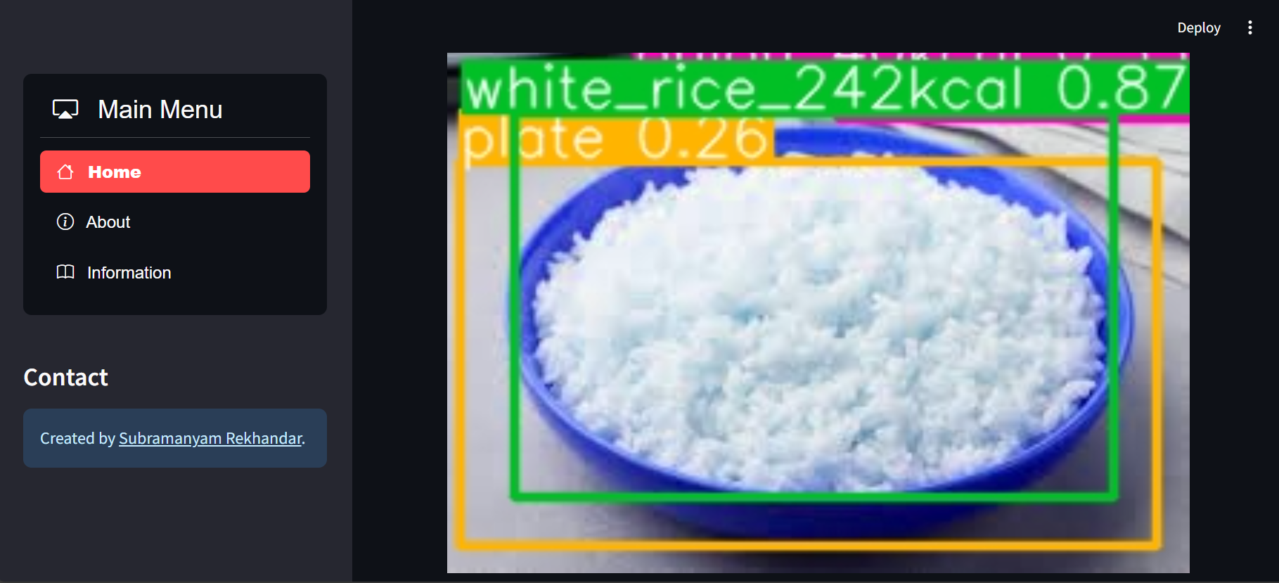

Slide 24
Conclusion & Future Work
Conclusion:
We are Proposing an image based calorie estimation system which will run without any external servers
Future Works:
System can give less accuracy when background is Non-uniform , light intensity is not good and due to that be categorization problems.
Good data Augmentation , more precise Input for the Models, Hyper parameter tuning
These are some things which will help make models more accurate in future .

Slide 25
Reference
An Automatic Calorie Estimation System of Food Images on a Smartphone Koichi Okamoto Keiji Yanai Department of Informatics, The University of Electro-Communications, Tokyo 1-5-1 Chofugaoka, Chofu, Tokyo 182-8585 JAPAN
P.Pouladzadeh, S.Shirmohammadi, and R.Almaghrabi, “Measuring Calorie and Nutrition from Food Image”, IEEE Transactions on Instrumentation & Measurement, Vol.63, No.8, p.p. 1947 – 1956, August 2014.
Parisa Pouladzadeh, Abdulsalam Yassine, and Shervin Shirmohammadi, “Foodd: An image-based food detection dataset for calorie measurement,” in InternationalConferenceonMultimediaAssistedDietaryManag ement, 2015
Meghana M Reddy, “Calorie-estimation-from-foodimages-opencv”, github repo, May 2016

Slide 26
Thank you!

